Slide 1
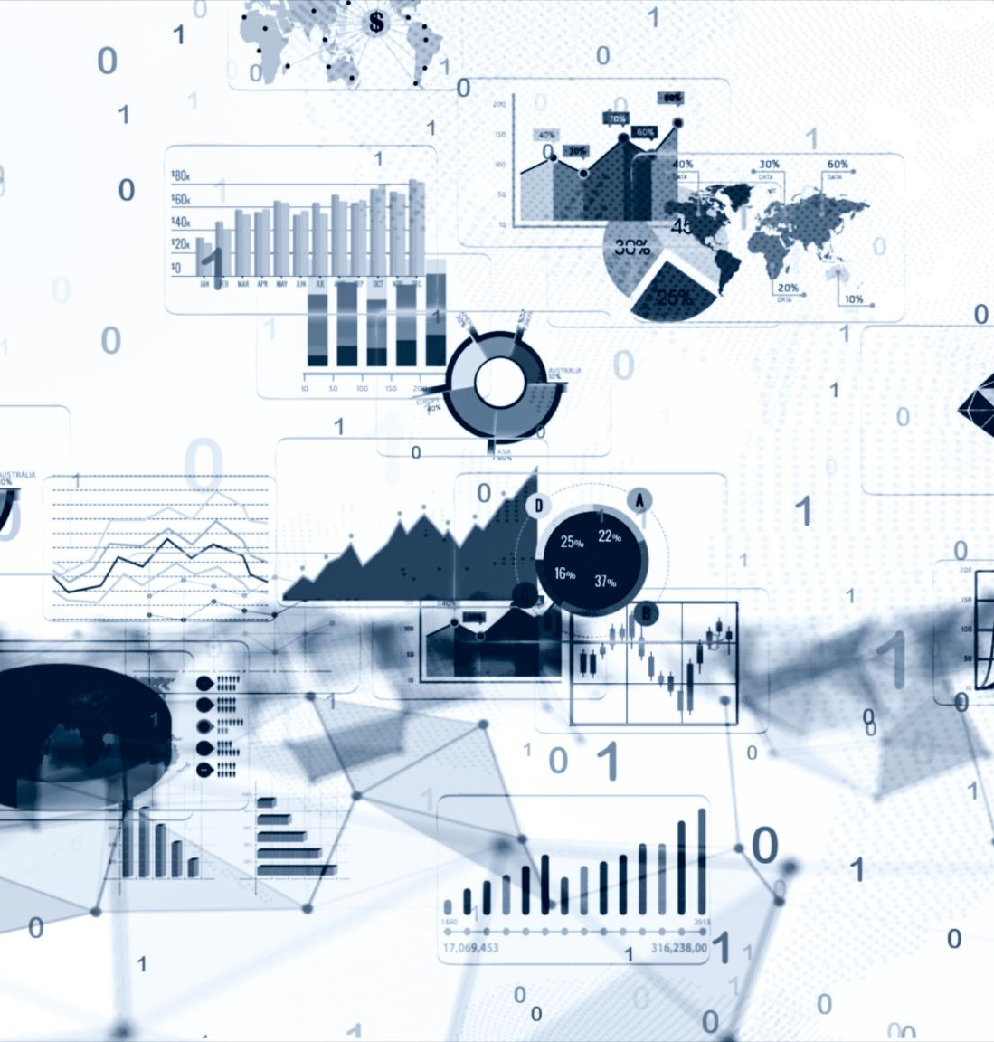
Exploring the Data Ecosystem
Understanding the many facets of data
Notes:
Data is the foundation of the digital age, and it comes in many forms, from structured data to unstructured data, to the emerging field of big data. In this presentation, we will delve into the various types of data and explore their differences, uses, and challenges.

Slide 2
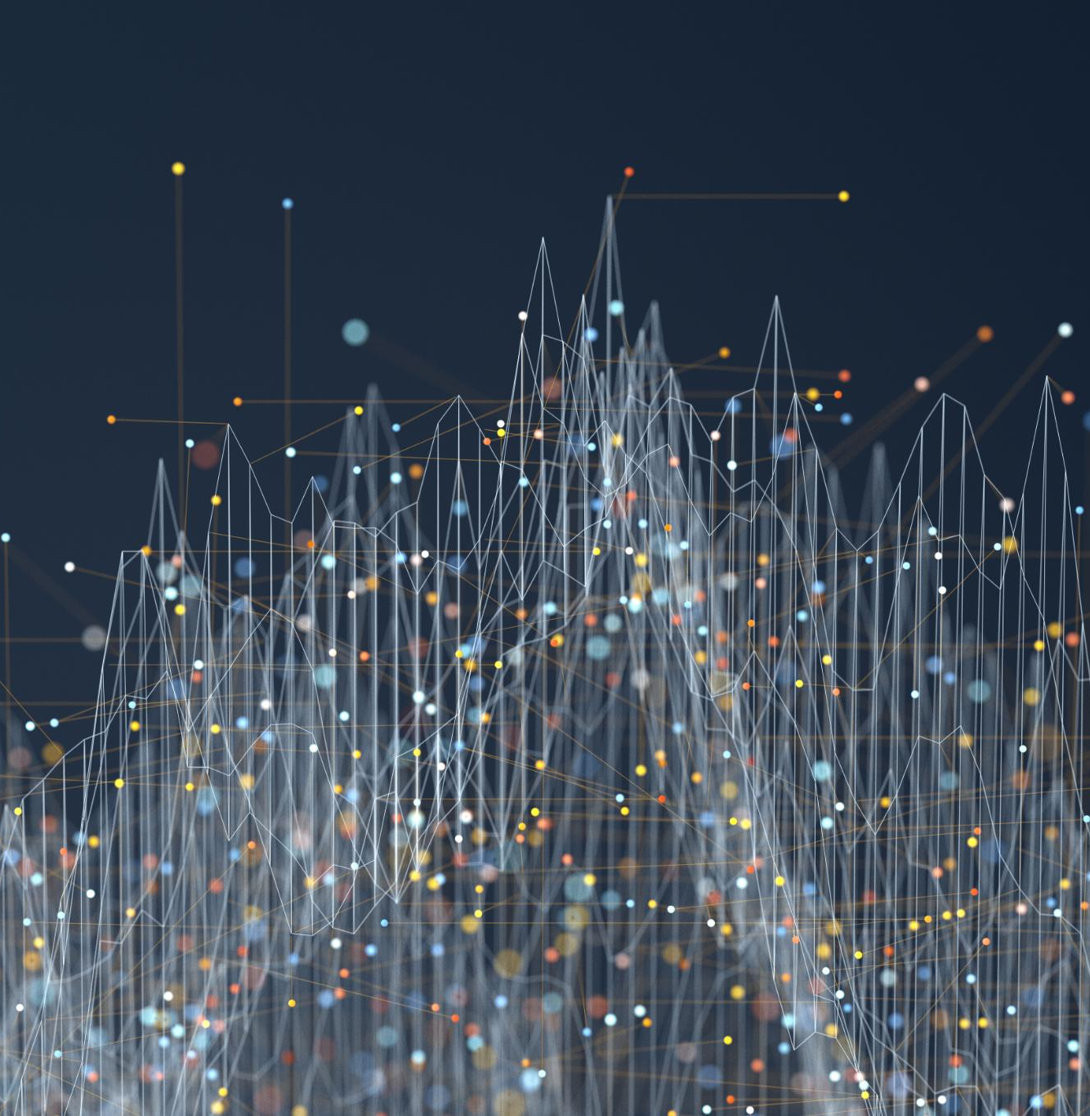
Presentation Overview
Structured and Unstructured Data
Big Data
Notes:
We will start by examining the differences between structured and unstructured data, and the benefits and challenges of each. Then, we will explore the emerging field of big data, its definition, technologies, and applications, and the challenges it brings.

Slide 3
Structured and Unstructured Data
Notes:
Structured and unstructured data are the two main types of data in the digital ecosystem. Structured data is organized, easily searchable, and easily analyzed, while unstructured data is difficult to categorize and analyze.

Slide 4
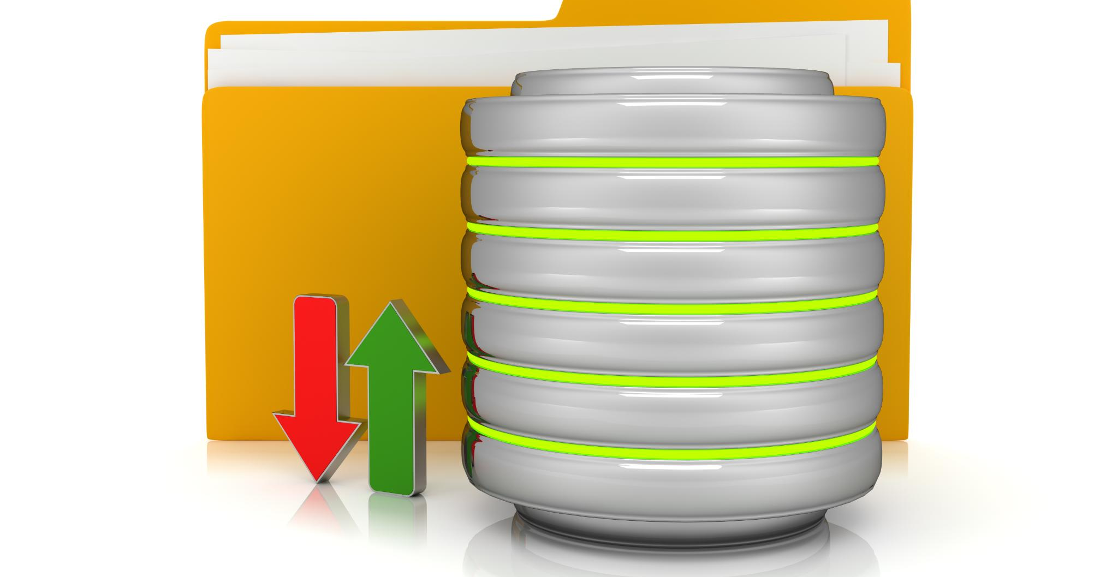
Structured Data
  Structured data is highly organized and easily searchable, allowing users to quickly find the information they need.
Notes:
Structured data is highly organized and easily searchable. It is typically stored in a database and can be easily analyzed with traditional data analytics tools.

Slide 5

Unstructured Data
Definition of Unstructured Data
  Unstructured data is data that does not follow a specific structure or format, making it difficult to manage and analyze with traditional data analytics tools.
Examples of Unstructured Data
  Examples of unstructured data include text, images, videos, audio files, and social media posts.
Challenges of Analyzing Unstructured Data
  Unstructured data is difficult to analyze with traditional data analytics tools because of its lack of structure and format. It requires specialized tools and techniques to extract meaningful insights from unstructured data.
Notes:
Unstructured data is data that does not have a predefined data model or structure. Examples of unstructured data include text, images, and videos. It is difficult to analyze with traditional data analytics tools.

Slide 6

Semi-Structured Data
  Semi-structured data is a type of data that contains both structured and unstructured elements. It has some organizational structure, but also allows for flexibility in the data model and content.
Notes:
Semi-structured data is a combination of structured and unstructured data. It has some organizational structure, but also contains elements of unstructured data.

Slide 7
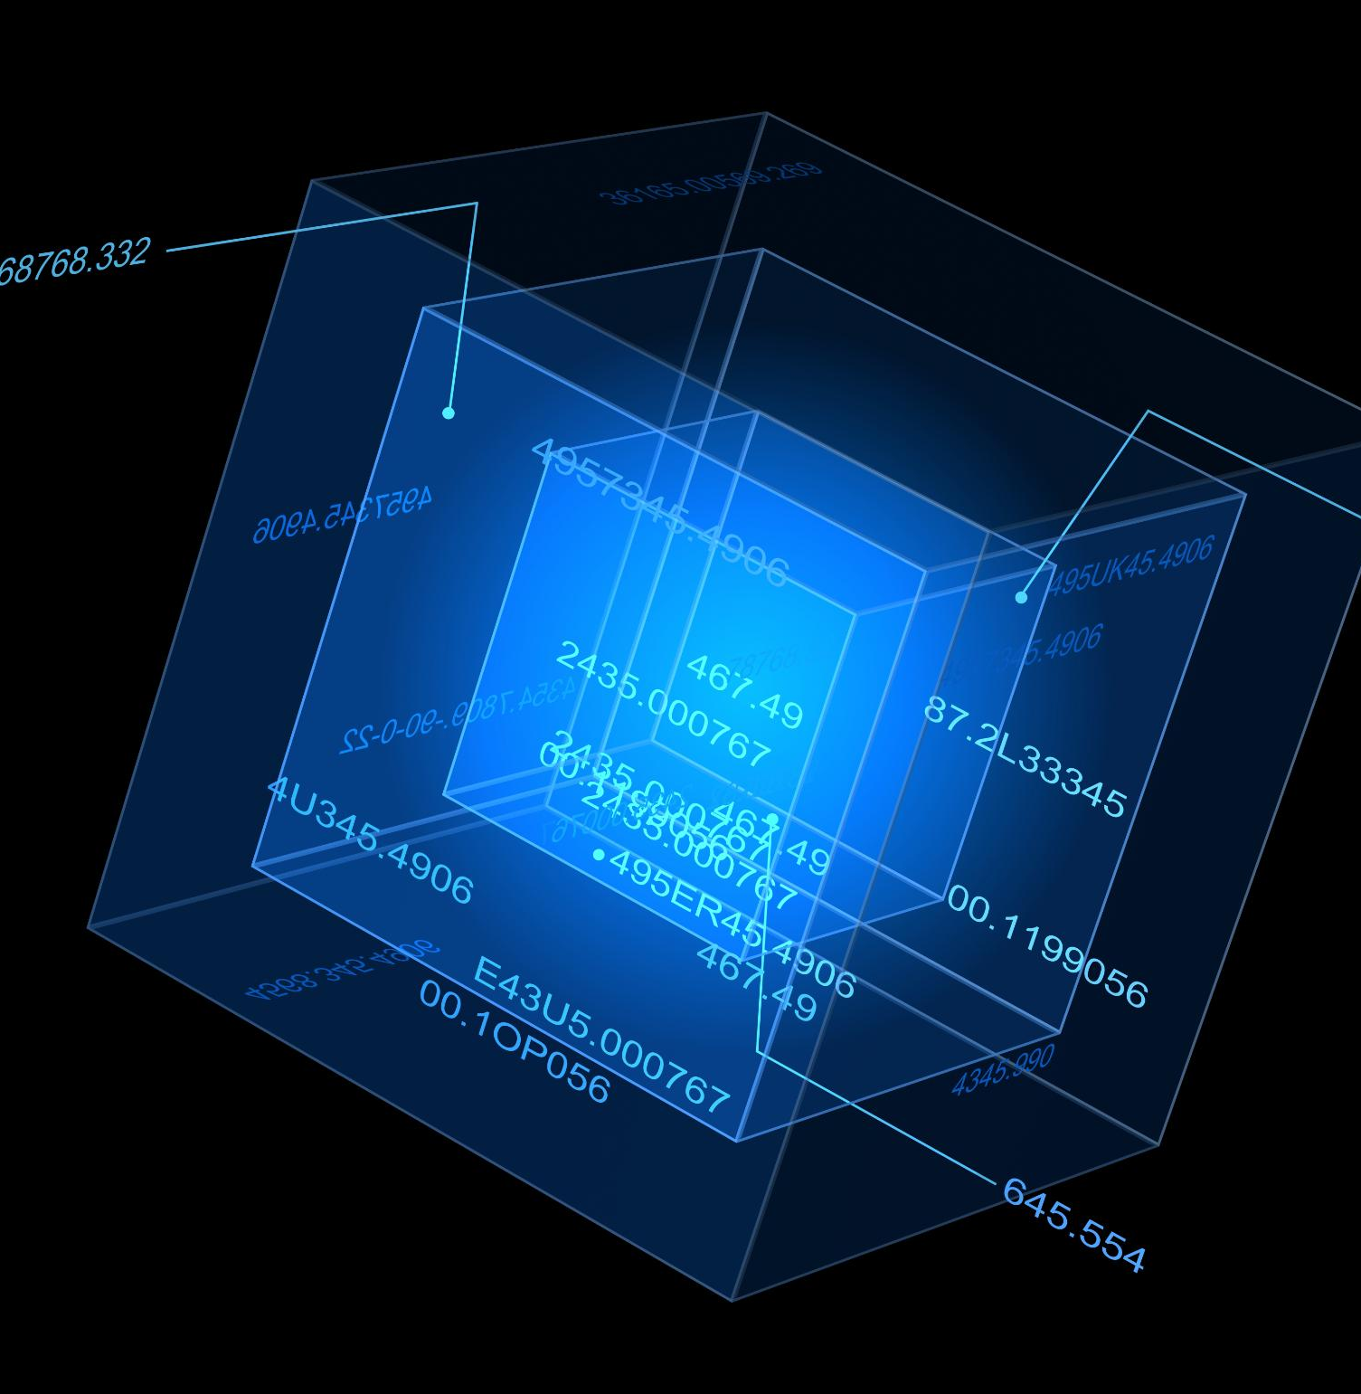
Differences and Use Cases
Structured Data
  Structured data is highly organized and can be easily analyzed using traditional data analytics tools. It is ideal for data that has a well-defined schema and is stored in tables or spreadsheets.
Unstructured Data
  Unstructured data is not organized and cannot be easily analyzed using traditional data analytics tools. It requires more advanced tools, such as natural language processing and machine learning. It is ideal for data that is not easily classified, such as social media posts and emails.
Notes:
Structured and unstructured data have different use cases and challenges. Structured data is ideal for traditional data analytics, while unstructured data requires more advanced tools, such as natural language processing and machine learning.

Slide 8
Big Data
Notes:
Big data is a term used to describe the large and complex datasets that are difficult to process with traditional data processing tools. The field of big data has emerged to help organizations make sense of this data and unlock its potential.

Slide 9
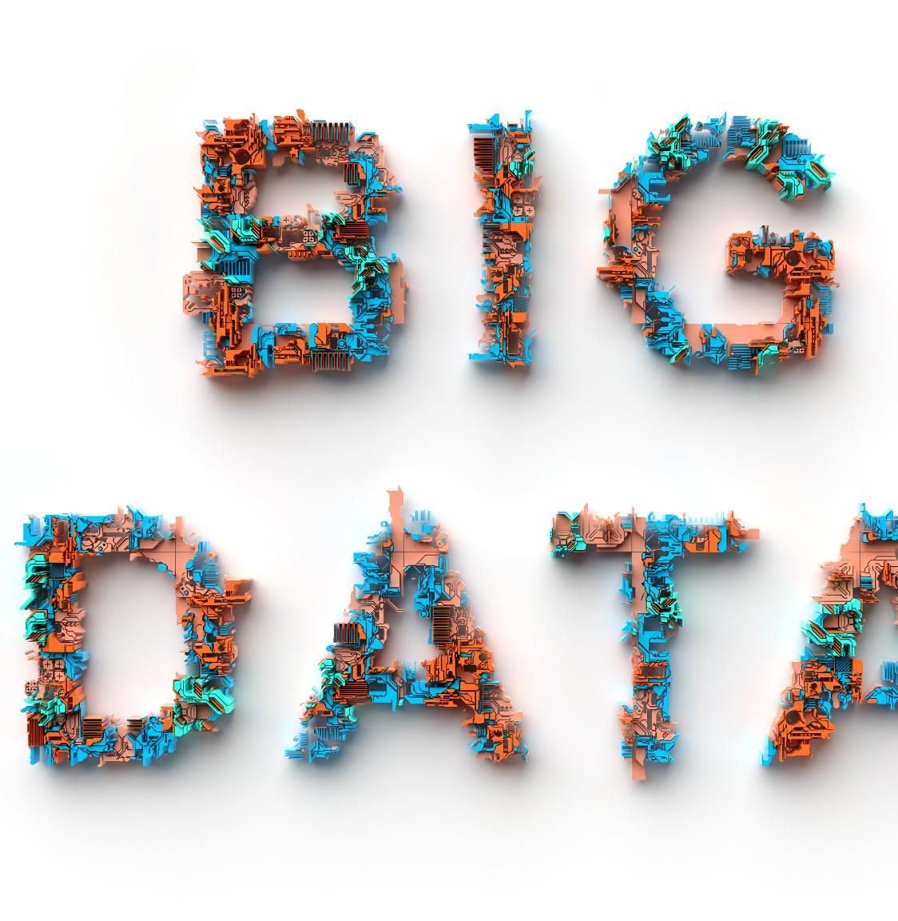
Definition of Big Data
  Big data is defined by the four Vs: volume, velocity, variety, and veracity. Volume refers to the sheer size of data, velocity refers to the speed at which data is generated, variety refers to the different types of data, and veracity refers to the accuracy and reliability of data.
Notes:
Big data is defined by the four Vs: volume, velocity, variety, and veracity. Big data is characterized by its sheer size, speed, and complexity.

Slide 10
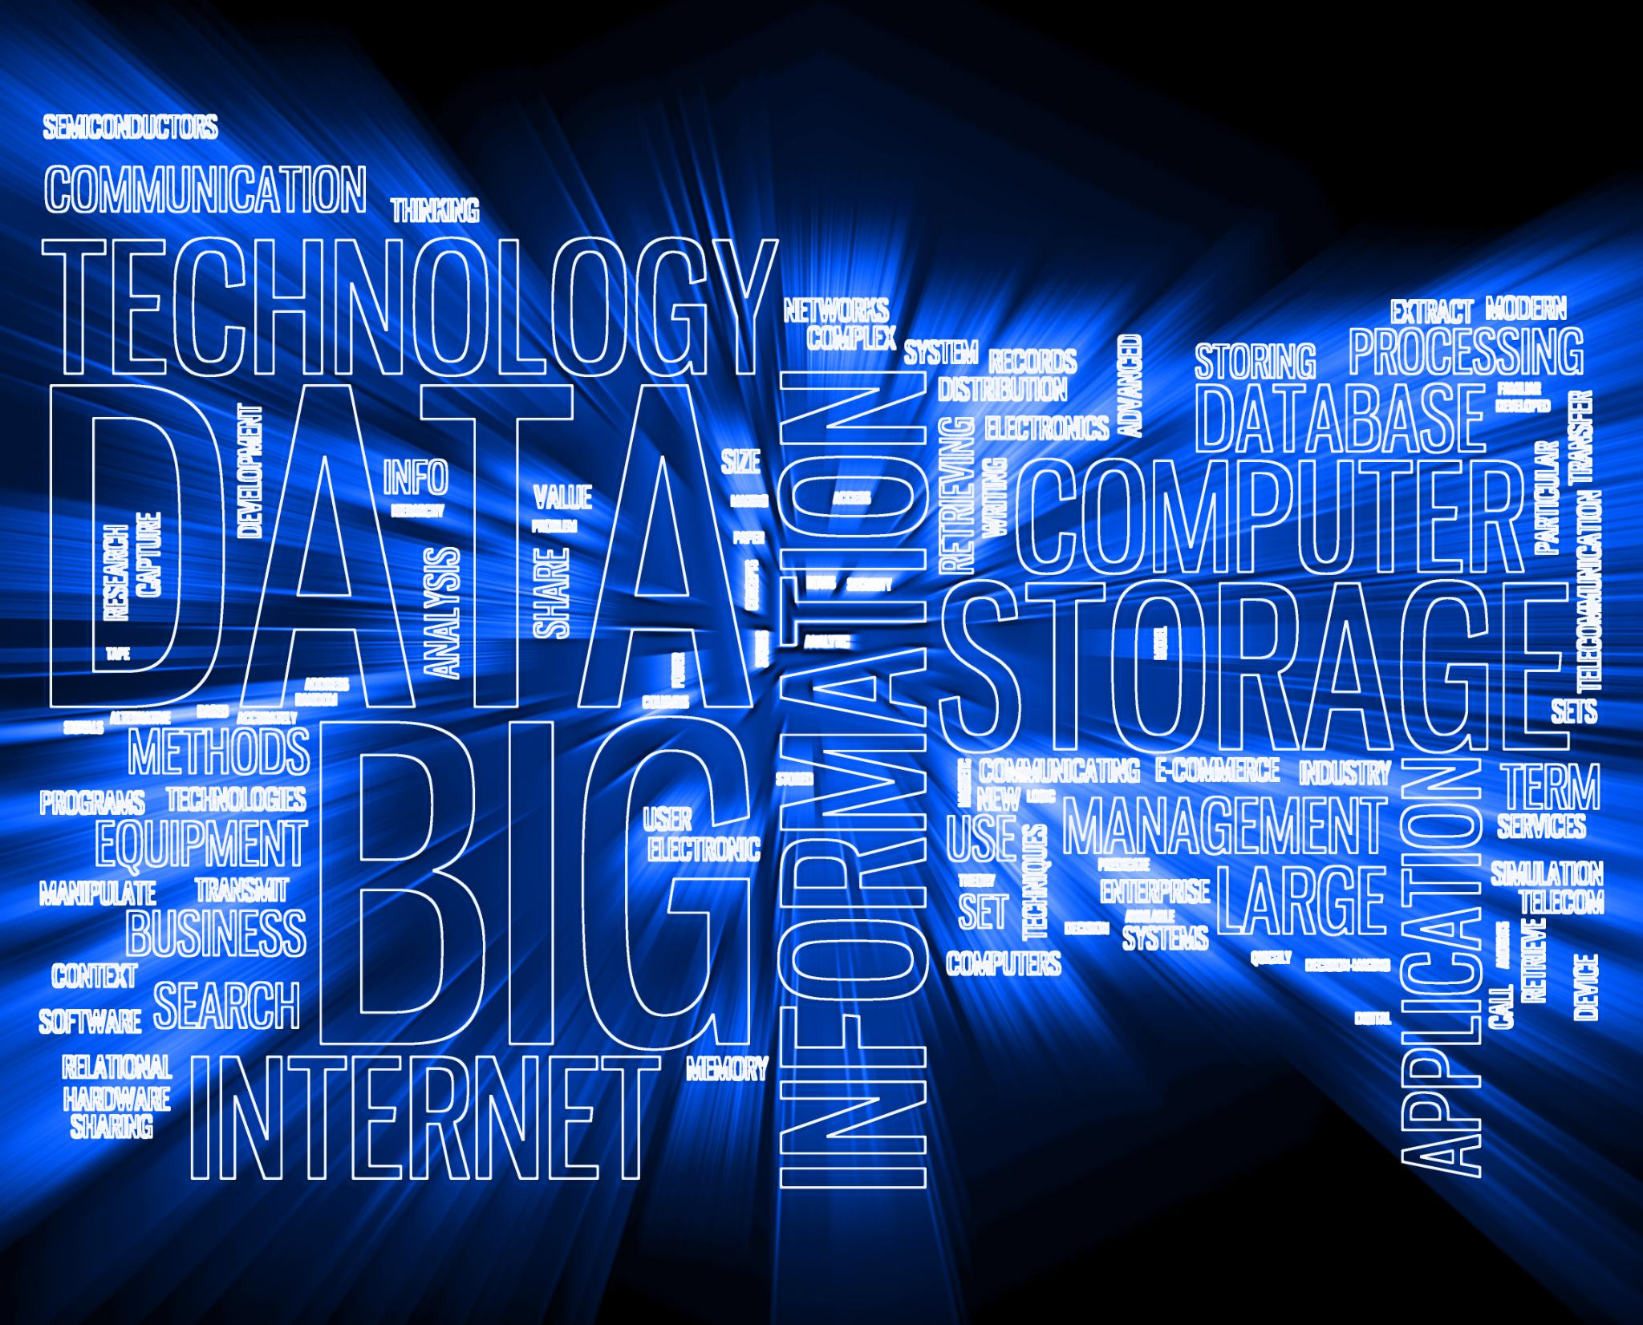
Big Data Technologies
Hadoop
  Hadoop is an open-source big data processing framework that allows large data sets to be stored and processed across clusters of computers. It is designed to scale from a single server to thousands of machines, offering fault tolerance and easy recovery from system failures.
Spark
  Spark is another popular open-source big data processing framework that is designed to be fast, flexible, and easy to use. Spark provides an interface for programming entire clusters with implicit data parallelism and fault tolerance.
NoSQL Databases
  NoSQL databases are designed to handle large and complex datasets that cannot be easily modeled in a tabular form. NoSQL databases provide high scalability, availability, and fault tolerance, making them well-suited for big data applications.
Notes:
Big data technologies are designed to handle the unique challenges of big data, such as Hadoop, Spark, and NoSQL databases. These technologies enable organizations to process, store, and analyze large and complex datasets.

Slide 11

Challenges of Big Data
  Big data poses several unique challenges, including data quality, security, and privacy. Technical challenges such as scalability and performance also present significant hurdles.
Notes:
Big data poses unique challenges, such as data quality, security, and privacy. In addition, there are technical challenges, such as scalability and performance.

Slide 12

Big Data Applications
Predictive Analytics
  Predictive analytics is a big data application that uses advanced algorithms to analyze large datasets and find patterns that can help predict future outcomes or trends.
Personalized Marketing
  Personalized marketing is a big data application that uses customer data to create targeted and relevant marketing campaigns that increase engagement and conversion rates.
Fraud Detection
  Fraud detection is a big data application that uses machine learning algorithms to analyze large amounts of financial data and identify patterns of fraudulent activity.
Notes:
Big data has many applications, including predictive analytics, personalized marketing, and fraud detection. It has the potential to transform many industries, from healthcare to finance.

Slide 13
Conclusion
Importance of Data
Data is the foundation of the digital age, and understanding the different types of data and their unique challenges and benefits is essential for any organization.
Structured Data
Structured data refers to data that is organized into a specific format, making it easy to search, sort, and analyze. It is commonly used in databases and spreadsheets.
Unstructured Data
Unstructured data refers to data that is not organized in a specific format, making it difficult to search, sort, and analyze. It includes data such as emails, social media posts, and images.
Big Data
Big data refers to data sets that are too large to be analyzed by traditional data processing tools. It requires specialized tools and technologies to store, process, and analyze.
Notes:
Data is the foundation of the digital age, and understanding the different types of data and their unique challenges and benefits is essential for any organization. Whether you're dealing with structured data, unstructured data, or big data, there are tools and technologies available to help you make sense of your data.

